Slide 1

AI-Based Patent Document
Classification Using Transformer Models
A hierarchical, explainable Transformer framework for IPC / CPC patent classification
Department of Computer Science | KLH University
Batch – 11
2420030504 – Vikas Suthar
2420030446 - Prakash Chawla
2420030486 – Vamshi
2420030791 – Om Panday

Slide 2
ROADMAP
Agenda
01
Problem Statement
05
Innovation, Creativity & Novelty
02
Objectives & Proposed Framework
06
Feasibility Analysis
03
Literature Survey
07
Project Plan & Workflow
04
Research Gap Identification
08
Dataset Sources & References
AI-Based Patent Document Classification Using Transformer Models
1

Slide 3
THE CHALLENGE
Problem Statement
“
Manual classification bottleneck
Examiners spend 20-30% of time on classification, driving up backlog.
To develop an AI-based patent document classification system using Transformer models that accurately categorizes patents into IPC/CPC taxonomies while providing interpretable explanations for classification decisions — addressing hierarchical inconsistency, poor long-tail performance, and limited cross-jurisdictional generalization.
Traditional ML limitations
SVM / Random Forest / KNN need heavy feature engineering, miss semantic nuance.
Hierarchical inconsistency
Flat multi-label models ignore parent-child taxonomy relationships.
Lack of explainability
Opaque AI decisions are unacceptable in legal / patent-office contexts.
Long-tail performance gap
Emerging technologies with few examples are routinely misclassified.
Cross-jurisdictional generalization
70,000+ IPC codes • 5 hierarchical levels • 3M+ patents filed annually
Models trained on USPTO degrade sharply on EPO or WIPO filings.
AI-Based Patent Document Classification Using Transformer Models
2

Slide 4
WHERE WE'RE HEADED
Objectives
Primary objective: build a Hierarchical Transformer-based Patent Classification Framework that…
1
Classify accurately across all 5 levels
Section → Class → Subclass → Group → Subgroup of the IPC/CPC taxonomy.
IPC / CPC HIERARCHY
Section (A–H)
2
Enforce hierarchical consistency
Specialized loss functions + constrained inference stop parent-child violations.
Class (A01)
3
Explain every prediction
SHAP, LIME and attention visualization make decisions auditable for legal use.
Subclass (A01B)
4
Generalize across jurisdictions
Group (A01B1/00)
Multi-dataset training and evaluation on USPTO, CLEF-IP and WIPO filings.
Handle rare / emerging technologies
Subgroup (A01B1/02)
5
Data augmentation and few-shot learning lift long-tail class performance.
AI-Based Patent Document Classification Using Transformer Models
3

Slide 5
THE MODEL
Proposed Framework Architecture
Input Layer
Patent document: abstract + claims + description
BUILT-IN FROM DAY ONE
Domain-adapted encoders
Preprocessing
Section segmentation, domain tokenization, technical-term handling
Hierarchical consistency
Transformer Encoder
SciBERT / Legal-BERT — multi-head self-attention (12–16 heads) + FFN
Hierarchical Classification Head
5-level softmax heads with hierarchical loss + constrained inference
Explainability-first design
Explainability Module
SHAP, LIME, attention visualization, faithfulness evaluation
Cross-dataset training
Output Layer
IPC/CPC codes, confidence scores, explanations, attention heatmaps
AI-Based Patent Document Classification Using Transformer Models
4

Slide 6
DESIGN RATIONALE
How the Framework Answers Each Limitation
Framework Feature | Description | Limitation It Addresses
Hierarchical classification head | Separate softmax layer per IPC level with consistency enforcement | Hierarchical inconsistency
Domain-adapted transformers | SciBERT (scientific text) + Legal-BERT (legal text) | Weak semantic understanding of patent language
Explainability integration | SHAP + LIME + attention visualization with faithfulness evaluation | Lack of explainability
Multi-dataset training | USPTO-70k + CLEF-IP 2011 + WIPO subset | Poor cross-jurisdictional generalization
Long-tail handling | Data augmentation + few-shot learning | Long-tail performance gap
AI-Based Patent Document Classification Using Transformer Models
5

Slide 7
PRIOR WORK
Literature Survey
Paper | Model / Approach | Outcome | Limitation | Dataset
PatentBERT (Lee & Hsiang, 2020) | BERT fine-tuned on patent claims | F1: 66.80% on CPC (9 classes) | Uses claims only; limited to 9 classes; no explainability | USPTO-3M
SciBERT-based Classification (Risch et al., 2020) | SciBERT (domain-adapted) | Outperforms standard BERT on patent tasks | Not tuned for legal language; limited explainability | USPTO-70k
Hierarchical Patent Classification (Pujari et al., 2021) | Hierarchical ML + Transformer features | Hierarchical F1: 0.68–0.72 | Limited context understanding; struggles with complex taxonomies | CLEF-IP 2011
THMM (Yadrintsev et al., 2022) | Linguistically-supported KNN | Comparable to fastText; strong with limited data | Heavy feature engineering; limited semantic nuance | CLEF-IP (699K patents)
AI-Based Patent Document Classification Using Transformer Models
6

Slide 8
PRIOR WORK
Literature Survey
Paper | Model / Approach | Outcome | Limitation | Dataset
PatentSBERTa + KNN (Bekamiri et al., 2024) | Sentence-BERT + KNN | F1: 66.0% on CPC (663 classes) | Similarity-focused; not optimized for classification | Custom patent dataset
LSG-Norm Attention (Condevaux & Harispe, 2023) | LSG-Norm attention (128/4) | Micro-F1: 70.0%; Macro-F1: 64.4% | Complex custom attention; limited cross-dataset validation | ccdv/patent-classification
PCT-BERT (Sahu et al., 2023) | RoBERTa + LLM-generated summaries | F1: 0.86 (state-of-the-art) | Needs extra LLM inference; prompt optimization understudied | USPTO-70k
H-ProtoRAG (Xie et al., 2024) | Hierarchical retrieval-augmented generation | F1: 0.87 (then-current SOTA) | Complex architecture; limited cross-dataset evaluation | USPTO-70k + WIPO
AI-Based Patent Document Classification Using Transformer Models
7

Slide 9
PRIOR WORK
Literature Survey
Paper | Model / Approach | Outcome | Limitation | Dataset
LLMs for Patent Classification (Emer et al., 2026) | BERT / SciBERT / PatentSBERTa vs. zero-/few-shot LLMs | Encoders excel on frequent classes; LLMs better on rare tech | LLMs ~3 orders of magnitude slower / costlier | USPTO-70k
AI-assisted Patent Classification (Lin, 2026) | BERT / T5 / DeepSeek + LoRA + quantization | BERT slightly outperforms DeepSeek; both viable | Limited to IPC G06 class; Chinese patents only | Taiwan Patent Data (2021–2025)
XLNet-based Pretraining (Lis & Rutkowski, 2026) | XLNet self-supervised pretraining | Scalable, robust classification method | Computationally intensive; limited public implementation | USPTO / WIPO patent data
PatenTEB (Ayaou & Cavallucci, 2025) | Multi-task training on 15 tasks (2.06M examples) | Multi-task training improves external generalization | Performance trade-offs across benchmark tasks | PatenTEB benchmark
AI-Based Patent Document Classification Using Transformer Models
8

Slide 10
WHERE PRIOR WORK FALLS SHORT
Research Gap Identification
1
Hierarchical Consistency Modeling
2
Explainability
3
Cross-Jurisdictional Generalization
Current state: Models treat IPC/CPC as flat multi-label prediction.
Impact: Predictions violate parent-child taxonomy constraints, undermining prior-art search.
Our solution: Hierarchical loss functions + constrained inference.
Current state: Research focuses on accuracy; explanation quality is rarely evaluated.
Impact: Unexplained AI decisions are unacceptable in legal settings; low examiner trust.
Our solution: SHAP + LIME + attention, with faithfulness / trust studies.
Current state: Most models are trained and evaluated on USPTO alone.
Impact: Deployed systems fail on EPO / WIPO patents with different structures.
Our solution: Multi-dataset training and evaluation: USPTO-70k + CLEF-IP + WIPO.
AI-Based Patent Document Classification Using Transformer Models
9

Slide 11
WHERE PRIOR WORK FALLS SHORT
Research Gap Identification
4
Long-Tail Technology Classification
5
Efficiency vs. Performance
6
Multimodal Integration
Current state: Severe class imbalance across the taxonomy.
Impact: Breakthrough innovations in nascent fields are misclassified or missed.
Our solution: Data augmentation (paraphrasing, sentence shuffling) + few-shot learning.
Current state: LLMs help on rare classes but cost ~3 orders of magnitude more to run.
Impact: Practical deployment is limited by compute and environmental cost.
Our solution: Efficient encoders (SciBERT/Legal-BERT) for frequent classes, augmented data for the tail.
Current state: Research is almost exclusively text-only; drawings are ignored.
Impact: Visual-centric (mechanical, design) patents risk misclassification.
Our solution: Planned future work: Vision Transformers for patent drawings.
AI-Based Patent Document Classification Using Transformer Models
10

Slide 12
WHAT SETS THIS APART
Innovation
Innovation | Description | Novelty Level
Hierarchical consistency enforcement | Specialized loss + constrained inference for taxonomic consistency | High
Explainability-first design | SHAP/LIME built in from the start, not bolted on afterward | High
Cross-jurisdictional validation | Systematic evaluation across USPTO, EPO and WIPO datasets | Medium–High
Hybrid encoder + LLM approach | Efficient encoders plus augmentation for long-tail categories | Medium
AI-Based Patent Document Classification Using Transformer Models
11

Slide 13
CREATIVE CHOICES
Creativity & Novelty
CREATIVITY
NOVELTY
Framework design: First framework to combine hierarchical classification, explainability, cross-dataset evaluation and long-tail optimization in one system.
Section-weighted input
Claims > Descriptions > Abstracts, with learned attention weights per section.
Hierarchical loss: Novel loss that penalizes parent-child violations, weighted by taxonomic distance.
Patent-specific augmentation
Sentence shuffling (claims are often independent) + domain-adapted paraphrasing.
Evaluation protocol: Multi-dimensional: classification metrics + hierarchical metrics + explainability faithfulness.
Interactive explanation dashboard
Heatmaps + natural-language rationales for examiners to explore and validate.
Resource-constrained approach: Targets competitive performance under limited compute budgets.
AI-Based Patent Document Classification Using Transformer Models
12

Slide 14
CAN WE BUILD IT
Feasibility — Technical & Resources
TECHNICAL FEASIBILITY
RESOURCE REQUIREMENTS
Aspect | Assessment
Model availability | High — BERT, RoBERTa, SciBERT, Legal-BERT on Hugging Face
Dataset availability | High — USPTO-70k, CLEF-IP 2011, WIPO publicly available
Compute resources | Moderate — GPU needed (Colab Pro or similar) for fine-tuning
Implementation complexity | Moderate — standard PyTorch + Hugging Face ecosystem
Explainability integration | High — SHAP and LIME libraries are readily available
Hardware
NVIDIA T4-class GPU — approx. $0.50–$1.00/hr (Colab Pro)
Software
Python 3.8+, PyTorch, Hugging Face Transformers — free / open-source
Data storage
100–200 GB for datasets — Google Drive / Cloud
Timeline
8–12 weeks project duration
AI-Based Patent Document Classification Using Transformer Models
13

Slide 15
CAN WE BUILD IT
Feasibility — Risk Assessment & Mitigation
Risk | Probability | Impact | Mitigation
Limited compute resources | Medium | High | Use RoBERTa/BERT instead of LLMs; apply LoRA for memory efficiency
Overfitting on small data | Medium | Medium | Data augmentation, early stopping, cross-validation
Long-text token limits | High | Medium | Section-level processing; Longformer if required
Class imbalance | High | High | Class weighting, data augmentation, few-shot learning
Explainability evaluation is hard to define | Medium | Medium | Adopt clear faithfulness metrics established in prior literature
Conclusion: the project is technically feasible — pre-trained models, public datasets and established tooling are all in place; key challenges are well-defined and addressable within the timeline.
AI-Based Patent Document Classification Using Transformer Models
14

Slide 16
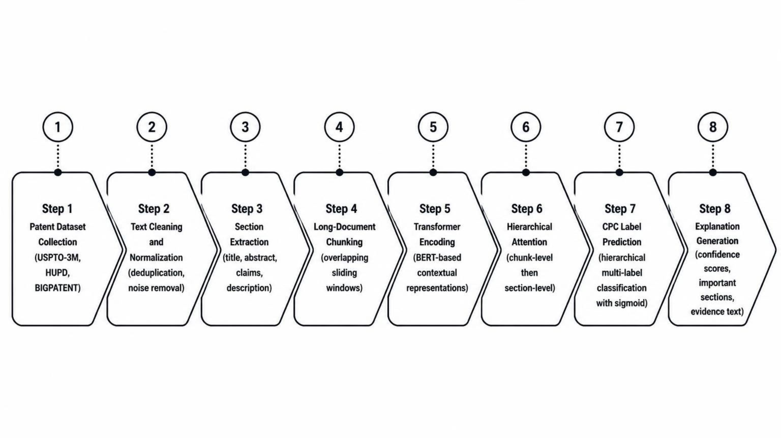
End-to-End Research Workflow

Slide 17
Methodology – PatentClass-HAT
Hierarchical Attention Transformer for Explainable Patent Classification
Step 1: Patent Dataset Collection
Collect patent datasets such as USPTO-3M, HUPD, and BIGPATENT.
Gather patent titles, abstracts, claims, descriptions, and CPC labels.
Step 2: Text Cleaning and Normalization
Remove duplicate patent documents.
Clean unwanted symbols and noise.
Normalize the text for model training.
Step 3: Section Extraction
Extract four important patent sections:
Title
Abstract
Claims
Description
Keep the sections separate for better understanding.
Step 4: Long-Document Chunking
Divide long patent documents into smaller text chunks.
Use overlapping sliding windows.
This helps the model process lengthy patent documents.
Step 5: Transformer Encoding
Use a BERT-based transformer to understand patent text.
Convert text into contextual numerical representations.
Capture the meaning of words and sentences.
Step 6: Hierarchical Attention
Apply chunk-level attention to identify important text chunks.
Apply section-level attention to identify important patent sections.
Combine the information to create a document representation.
Step 7: CPC Label Prediction
Use hierarchical multi-label classification.
Predict one or more CPC patent classification labels.
Use sigmoid activation for label probabilities.
Step 8: Explanation Generation
Generate confidence scores for predictions.
Identify important patent sections.
Display evidence text that supports the predicted labels.

Slide 18
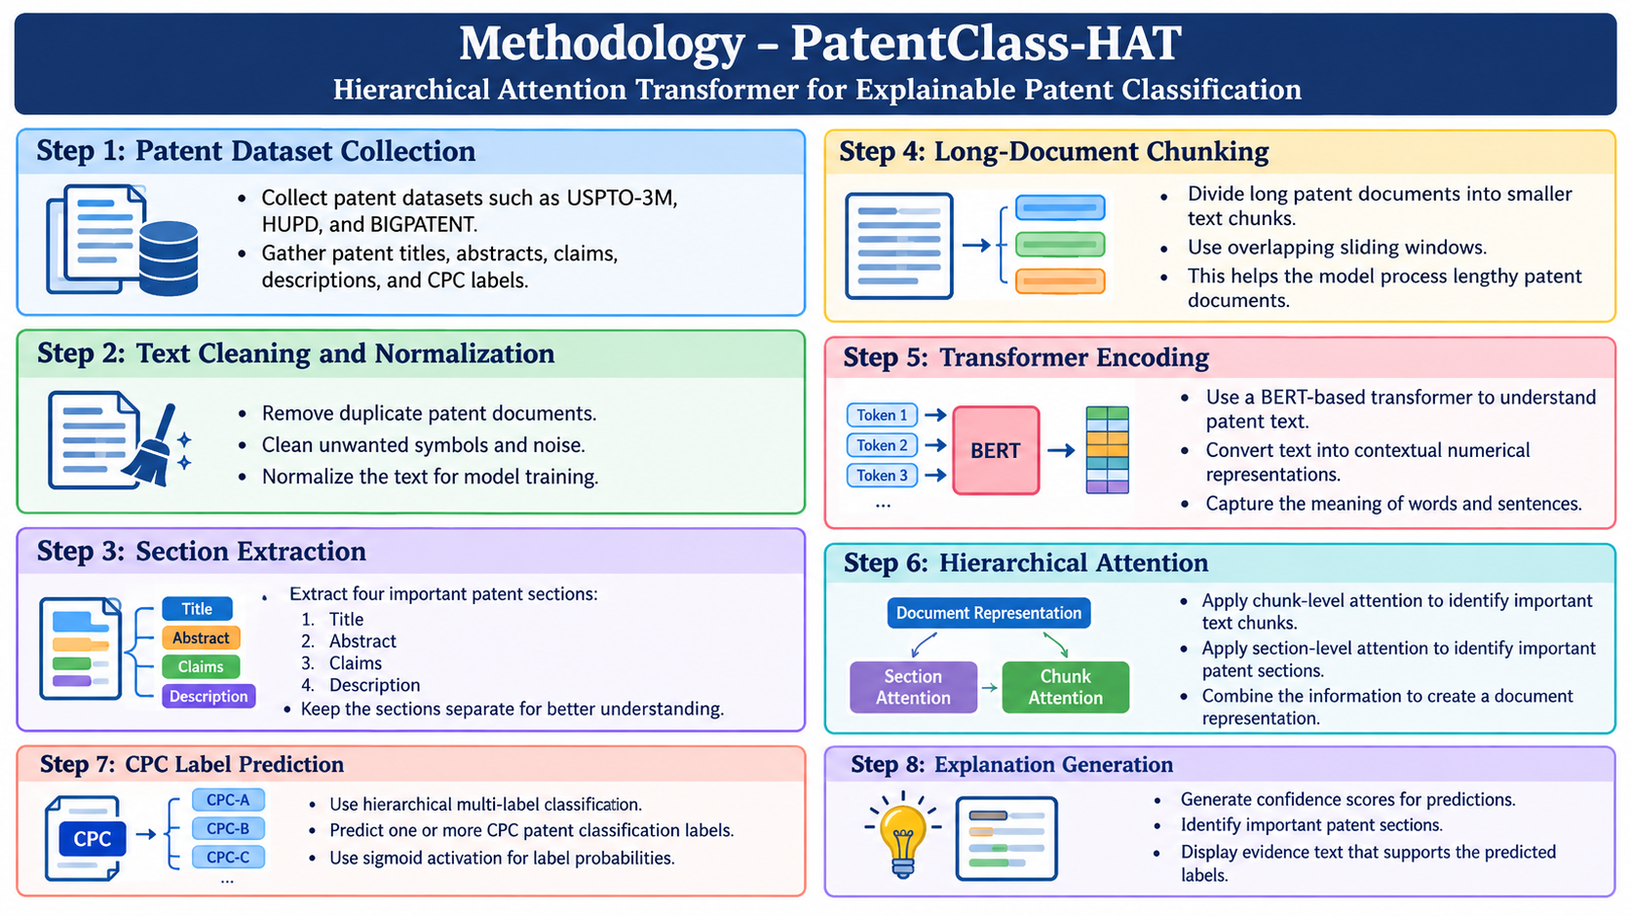

Slide 19
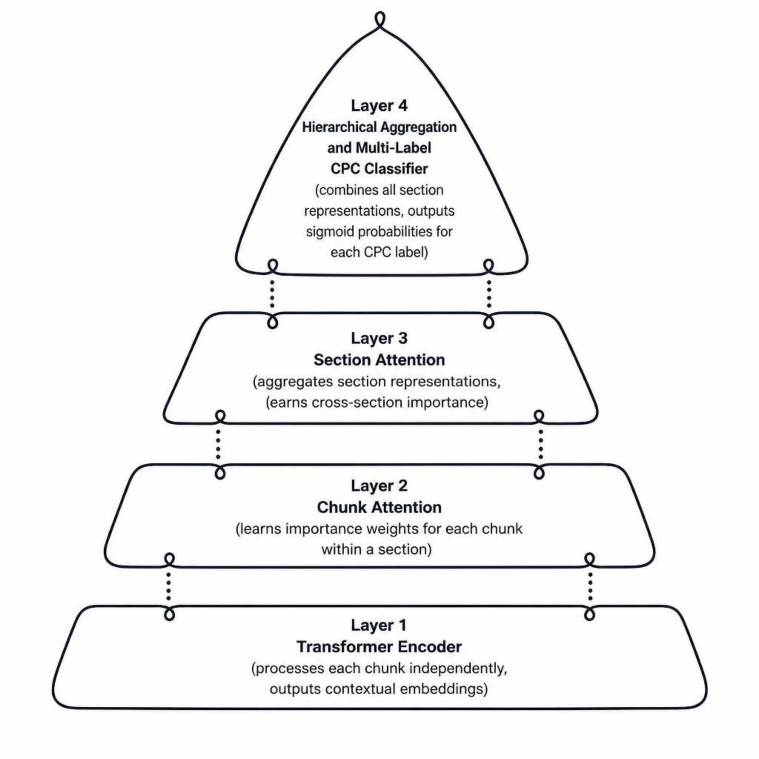
PatentClass-HAT Architecture
Input Sections
Title
Abstract
Claims
Description
Processing
Cleaning & Normalization
Tokenization
Overlapping Chunking
Output
CPC Labels + Confidence
Important Sections
Important Chunks
Evidence Text
Application Stack
React Frontend
FastAPI Backend
PyTorch Model
Optional PostgreSQL

Slide 20
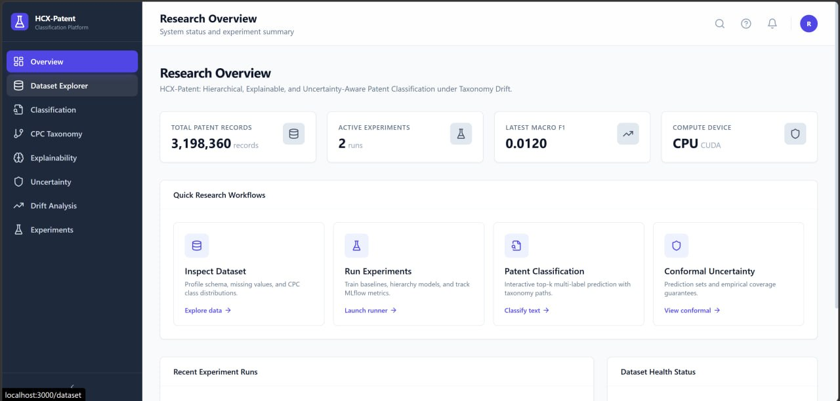

Slide 21
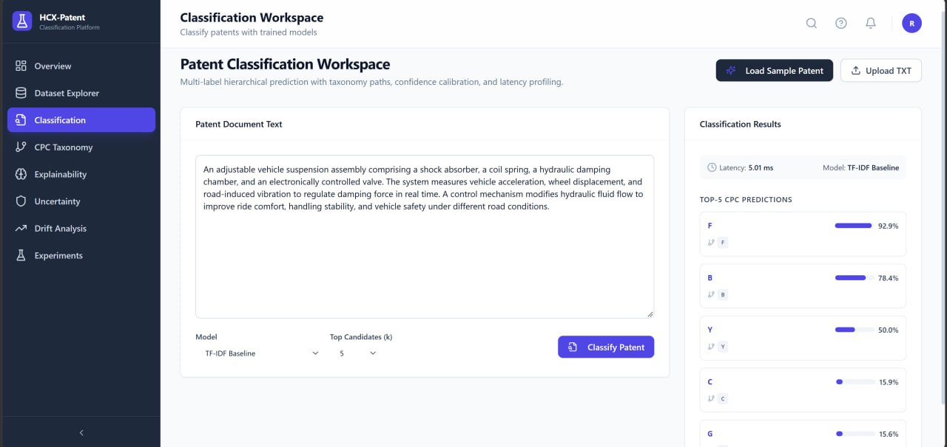

Slide 22
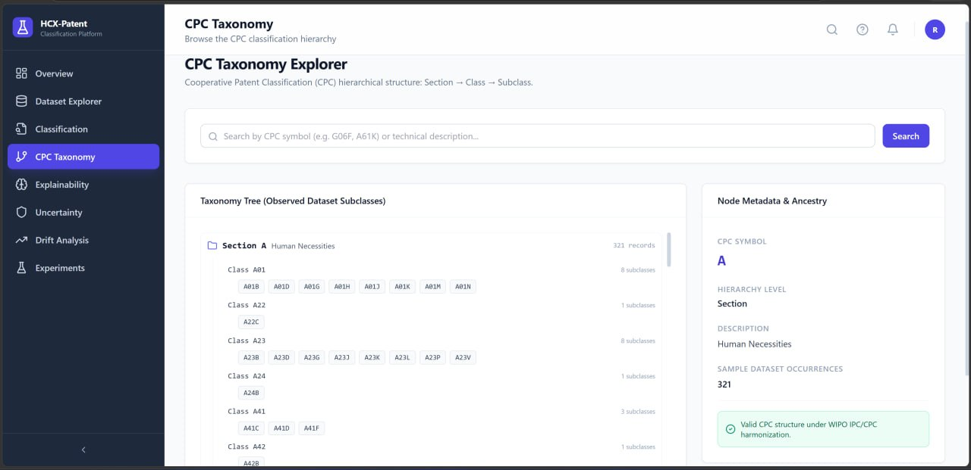

Slide 23

Modern Tools & Technologies
Programming
Deep Learning
Python, Pandas, NumPy, Scikit-learn
PyTorch, Hugging Face Transformers, MLflow, TensorBoard
GPU & Compute
Backend
CUDA, NVIDIA GPU
FastAPI
Frontend
Deployment
React, Tailwind CSS
Docker, Git, GitHub
Datasets
Evaluation
USPTO-3M, HUPD, BIGPATENT
Scikit-learn, Custom Hierarchical Metrics

Slide 24
Implementation Steps
01
Training Configuration
Data Acquisition & Verification
GPU Model | ___________
CUDA Version | ___________
Batch Size | ___________
Epochs | ___________
Training Time | ___________
Acquire and verify real patent data from USPTO-3M, HUPD, and BIGPATENT. Remove duplicates and extract sections.
02
Tokenization & Chunking
Tokenize and create overlapping chunks for each patent section.
03
Model Loading & Training
Load transformer on CUDA and train using PyTorch with BCEWithLogitsLoss. Save model checkpoints.
04
API & Frontend Integration
Create FastAPI endpoint, connect React frontend, and test with real patent documents.

Slide 25
Results & Performance Evaluation
Experiment Configuration
Comparative Results (To Be Filled)
Dataset Size | ___________
CPC Labels | ___________
Transformer Model | ___________
GPU Model | ___________
Training Time | ___________
Best Baseline | ___________
PatentClass-HAT | ___________
Main Observation | ___________
Model | Micro-F1 | Macro-F1 | Precision | Recall | Hamming Loss
TF-IDF + Logistic Regression | To be filled | To be filled | To be filled | To be filled | To be filled
TF-IDF + SVM | To be filled | To be filled | To be filled | To be filled | To be filled
CNN | To be filled | To be filled | To be filled | To be filled | To be filled
BiLSTM | To be filled | To be filled | To be filled | To be filled | To be filled
BERT Baseline | To be filled | To be filled | To be filled | To be filled | To be filled
PatentBERT | To be filled | To be filled | To be filled | To be filled | To be filled
PatentSBERTa | To be filled | To be filled | To be filled | To be filled | To be filled
PatentClass-HAT | To be filled | To be filled | To be filled | To be filled | To be filled
Additional Evaluation Metrics
Exact Match Ratio
Hierarchical Precision
Hierarchical Recall
Hierarchical F1
___________
___________
___________
___________
Inference Time
GPU Memory Usage
___________
___________

Slide 26
EXECUTION PLAN
Project Plan — End-to-End Workflow
1
2
3
4
5
6
Literature Review
& Planning
Data Collection
& Preprocessing
Model Implementation
& Training
Explainability
Integration
Evaluation
& Analysis
Deployment
& Documentation
Wk 1–2
Wk 3–4
Wk 5–7
Wk 7–8
Wk 8–10
Wk 10–12
Review papers, identify gaps, finalize architecture
Download USPTO/CLEF-IP/WIPO, segment, tokenize
SciBERT/Legal-BERT/RoBERTa, hierarchical loss, constrained inference
SHAP, LIME, attention viz, faithfulness & trust study
Classification + hierarchical metrics, cross-dataset validation, ablations
REST API, web demo, final report & presentation
AI-Based Patent Document Classification Using Transformer Models
15

Slide 27
EXECUTION PLAN
Project Plan — Timeline (Gantt)
 | W1 | W2 | W3 | W4 | W5 | W6 | W7 | W8 | W9 | W10 | W11 | W12
Literature review
Data collection & prep.
Model implementation
Model training
Explainability module
Evaluation & analysis
Deployment
Documentation & report
Presentation prep.
Active work in that week
AI-Based Patent Document Classification Using Transformer Models
16

Slide 28
DATASET SOURCES & REFERENCES
Where the Data — and the Ideas — Come From
Dataset | Link
USPTO-70k | uspto.gov/learning-and-resources/electronic-data-products/patent-classification-dataset
CLEF-IP 2011 | clef-initiative.eu/track/clef-ip-2023
WIPO patent corpus | wipo.int/standards/en/ipc
ccdv/patent-classification | huggingface.co/datasets/ccdv/patent-classification
Taiwan Patent Data | tipo.gov.tw
Core references: Lee & Hsiang (2020) • Risch et al. (2020) • Pujari et al. (2021) • Yadrintsev et al. (2022) • Bekamiri et al. (2024) • Condevaux & Harispe (2023) • Sahu et al. (2023) • Xie et al. (2024) • Emer et al. (2026) • Lin (2026) • Lis & Rutkowski (2026) • Ayaou & Cavallucci (2025)
AI-Based Patent Document Classification Using Transformer Models
17

